Slide 1
Food and Nutrition Services (FNS) Update
August 2022

Slide 2
Management Team
St. Louis Public Schools Food and Nutrition Services Department
Althea Albert-Santiago, MPH
Director of Food and Nutrition Services Department
Tenecia Williams
Accountability Specialist
Erika Hollinshed
Catering Specialist
Southwest Foodservice Excellence
Carolyn Penn
General Manager
Jackie Martin-Baker
Assistant General Manager
Faith Fude MA, RD
Nutrition Coordinator II

Slide 3
National School Breakfast & Lunch Program
Saint Louis Public Schools operates the Community Eligibility Provision Program, which allows all SLPS school students to eat a free breakfast, lunch, dinner, and snack without having to fill out a Family Application for Meal Benefits.
School Breakfast Program (SBP)
Breakfast served in the cafeteria
Breakfast in the Classroom
Grab ‘N Go Carts
Second Chance Breakfast
National School Lunch Program (NSLP)
Lunch served in the cafeteria
Lunch in the classroom
Grab ‘N Go Carts
All food programs are required to have written approval by Althea Albert-Santiago, Director of Food and Nutrition Services

Slide 4
Compliance Guidelines
Service Times
Service periods cannot be changed without a written request to Althea Albert-Santiago, Director of Food
and Nutrition Services
All service times are approved by the Department of Education and Secondary
Education (DESE) and the Missouri Department of Health and Senior Services (MDHSS).
In School Suspensions
United States Department of Agriculture (USDA) states you cannot punish the students
with food.
Students must receive a reimbursable meal.
Menus cannot be changed without a written request.
The Child and Adult Care Food Program (CACFP)
The CACFP program is sponsored by the MDHSS. ​
Schools that provide an afterschool program that includes educational, enrichment, and/or athletics programs are eligible to participate
Food and Nutrition Services offers dinner and snacks to all scholars
Hot or cold meals are offered ​
Protocol: All schools requesting this program will need to submit a written request to Althea Albert-Santiago

Slide 5
Compliance Guidelines
Smart Snack Guidelines include changes in calories, sodium, fat, and sugar for both snacks and beverages and regulates vending machines, fundraisers and school stores.
Schools Stores
St. Louis Board of Education Regulation: Business and Non-Instructional Operations Policy R3542.2.3
Only allowed to sell non-food items during the school day.
No food items will be sold during breakfast or lunch in competition with the National School Breakfast and Lunch Program.
Fundraisers
Non-food item fundraisers are allowed during the school day.
The standards only apply during school hours (midnight the night before to 30 minutes after the school day ends)
Protocol: All schools requesting fundraisers will need to submit a written request to Althea Albert-Santiago
Check the fundraiser’s ideas on the Food and Nutrition webpage
Water
Water is offered to all students during breakfast and lunch

Slide 6
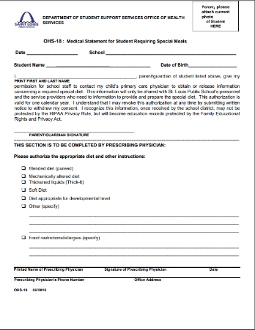
Compliance Guidelines
Special Diet form (OHS-18)
Written documentation from a licensed practitioner
Diet order
Identification of the medical or other special dietary condition which restricts the student’s diet
The food or foods omitted from the student’s diet
The food or choice of foods to be substituted
Signature from a licensed practitioner
New documentation is needed each year to the school nurse or administrator
The health and nutrition team will create a new menu based on the student’s dietary needs
The food service staff will prepare the meal for the student

Slide 7
Fresh Fruit and Vegetable Program
The Goal of the FFVP
Create healthier school environments by providing healthier food choices
Expand the variety of fruits and vegetables children experience
Increase children’s fruit and vegetable consumption
Make a difference in children’s diets to impact their present and future health
To be selected for the FFVP, a school must:
Be an elementary school
Have a high percentage of students eligible for the Community Eligibility Provision Program
Participate in the NSLP
Complete an annual application for the FFVP
Make free fresh fruits and vegetables available to all enrolled children
Provide fresh fruits and vegetables only during the school day (not before or after school or during summer school)
Widely publicize within the school the availability of free fresh fruits and vegetables
Have documented support of the food service manager, principal, and district superintendent
Serve free fresh fruits and vegetables outside of the NSLP and SBP meal periods five days per week
The staff works with the FFVP coordinator
For additional information, please contact:
Tenecia Williams, Accountability Specialist
Tenecia.williams@slps.org or 314-345-2308

Slide 8
Catering Services
Booking An Event
Contact and email Erika Hollinshed, Catering Services Coordinator in Food Nutrition Services for all catering requests.
Please copy Carolyn Penn, SFE General Manager of Food Services Carolyn.Penn@sfellc.org and Althea Albert-Santiago, Director Food and Nutrition Services Department Althea.Albert-Santiago@slps.org on all catering requests.
Catering requests must be submitted via email Monday-Friday by 3pm. Next day catering orders will not be accepted.
Complete the Saint Louis Public Schools Catering Request Form within FIVE (5) days from the day of the event.
The Catering Request Form, Order Confirmation, and Invoice will be emailed within 24 hours after booking the event
After the event, it is the client’s responsibility to complete all required forms for payment (i.e. Checklist for invoice payments and reimbursements, voucher certification forms, etc. Submit all payments to Beverly Foster, Accounts Payable Supervisor at Beverly.foster@slps.org. Contact number: 314-345-2493.
For additional information, please contact:
Erika.Hollinshed,Catering Services Coordinator
Erika. Hollinshed @slps.org or 314-345-2308

Slide 9
Roving Chef Program, Rainbows & Butterflies
&
Nutrition Education Classroom Program
Roving Chef Program Overview:
A District Chef and Registered Dietitian will present an interactive cooking class with the students
Students will learn basic culinary terms and understand the benefits of eating healthy
10-12 students are in each class and each class is 45 minutes
Kitchen tours are offered as a component of the class
Students are given a Certificate of Participation along with a copy of the recipe
Rainbows & Butterflies Overview:
Conducted by the Health and Nutrition Team
Geared for PreK-1st Grade
Students learn fruit and vegetable basics
Nutrition Education Classroom Program Overview:
Presented by the Health and Nutrition Team
Nutrition Educations Topics: Healthy Eating, MyPlate basics, The Importance of Breakfast, and Portion Control
15-30 students are in each class and each class is 45 minutes
Interactive Activities: Taste Testing and Food Demonstrations

Slide 10
Roving Chef Program, Rainbows & Butterflies
&
Nutrition Education Classroom Program
How to Book :
Principals and teachers should contact
Althea Albert-Santiago, MPH, CCNP, CMP, Director of Food and Nutrition Services, 314-934-5302 althea.albert-santiago@slps.org
Faith Fude, MS, RD Nutrition Coordinator II Southwest Foodservice Excellence, 314-381-4155 faith.fude@sfellc.org
After the Principals contact Althea Albert-Santiago or Faith Fude, the Principals will schedule the Roving Chef Program and/or the Nutrition Education Classroom Programs.
After the event is booked, the Principals will receive a confirmation letter including dates, times, and procedures on how to prepare for the Roving Chef Program and/or the Nutrition Education Classroom Program within five business days.
If the Principals do not receive their confirmation letter within five business days, they should contact Althea Albert-Santiago at 314-934-5302 or althea.albert-santiago@slps.org or Faith Fude, MS, RD Nutrition Coordinator II at 314-381-4155 or faith.fude@sfellc.org

Slide 11
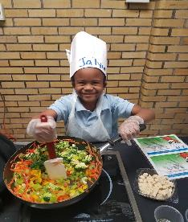
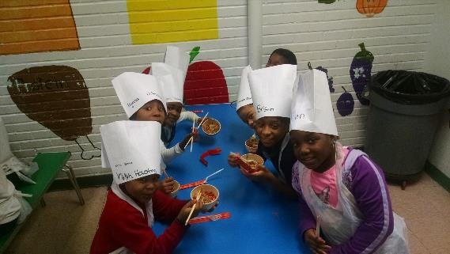
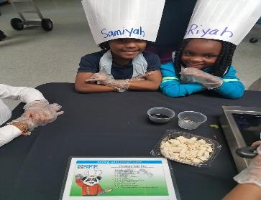
Roving Chef Program

Slide 12
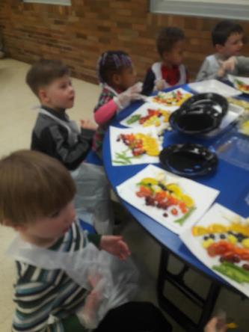
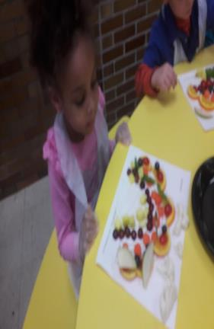
Rainbows & Butterflies

Slide 13
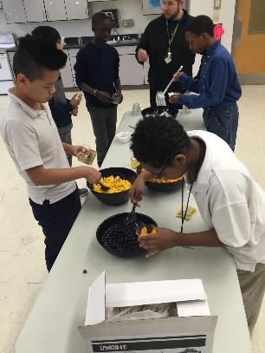
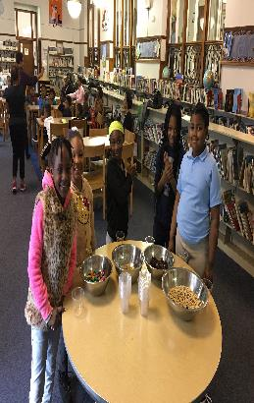
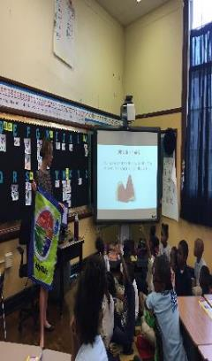
Nutrition Education Classroom Program
August 2022

Slide 14
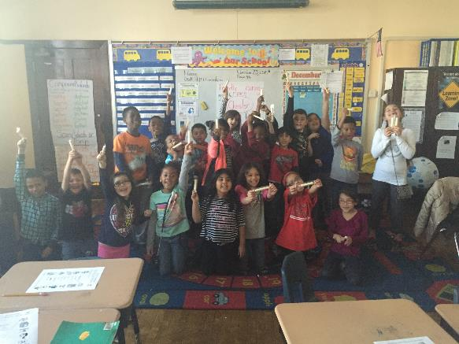
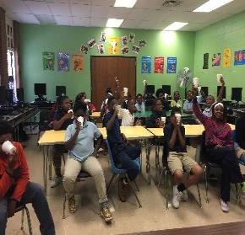
Nutrition Education Classroom Program

Slide 15
Non-discrimination Statement
In accordance with federal civil rights law and U.S. Department of Agriculture (USDA) civil rights regulations and policies, this institution is prohibited from discriminating on the basis of race, color, national origin, sex (including gender identity and sexual orientation), disability, age, or reprisal or retaliation for prior civil rights activity.
Program information may be made available in languages other than English. Persons with disabilities who require alternative means of communication to obtain program information (e.g., Braille, large print, audiotape, American Sign Language), should contact the responsible state or local agency that administers the program or USDA’s TARGET Center at (202) 720-2600 (voice and TTY) or contact USDA through the Federal Relay Service at (800) 877-8339.
To file a program discrimination complaint, a Complainant should complete a Form AD3027, USDA Program Discrimination Complaint Form which can be obtained online at: https://www.usda.gov/sites/default/files/documents/USDA-OASCR%20P-ComplaintForm-0508-0002-508-11-28-17Fax2Mail.pdf, from any USDA office, by calling (866) 632-9992, or by writing a letter addressed to USDA. The letter must contain the complainant’s name, address, telephone number, and a written description of the alleged discriminatory action in sufficient detail to inform the Assistant Secretary for Civil Rights (ASCR) about the nature and date of an alleged civil rights violation. The completed AD-3027 form or letter must be submitted to USDA by:
1. mail:
U.S. Department of Agriculture Office of the Assistant Secretary for Civil Rights 1400 Independence Avenue, SW Washington, D.C. 20250-9410; or
2. fax:
(833) 256-1665 or (202) 690-7442; or
3. email:
Program.Intake@usda.gov
This institution is an equal opportunity provider.

Slide 16
Contact Information
Southwest Foodservice Excellence (SFE)
Carolyn Penn, General Manager
Carolyn.penn@sfellc.org
Cell Number: 314-637-4841
Southwest Office Number: 314-381-4155
Jackie Martin-Baker, Asst. General Manager
Jackie.martin-baker@sfellc.org
Office Number: 314-381-4155
Faith Fude, Nutrition Coordinator II
Sarah.drayton@sfellc.org
Office Number: 314-381-4155
SFE Office Number: 314-381-4155
Food and Nutrition Services Department
Althea Santiago, Director of Food/ Nutrition Services
Althea.albert-Santiago@slps.org
District Cell Number: 314-934-5302
Office Number: 314-345-4519
Tenecia Williams, Accountability Specialist
Tenecia.williams@slps.org
Office Number: 314-345-2308
Erika Hollinshed, Catering Services Specialist
Erika.Hollinshed@slps.org
Number: 314-331-6115
SLPS Office Number: 314-345-2308

